Slide 1
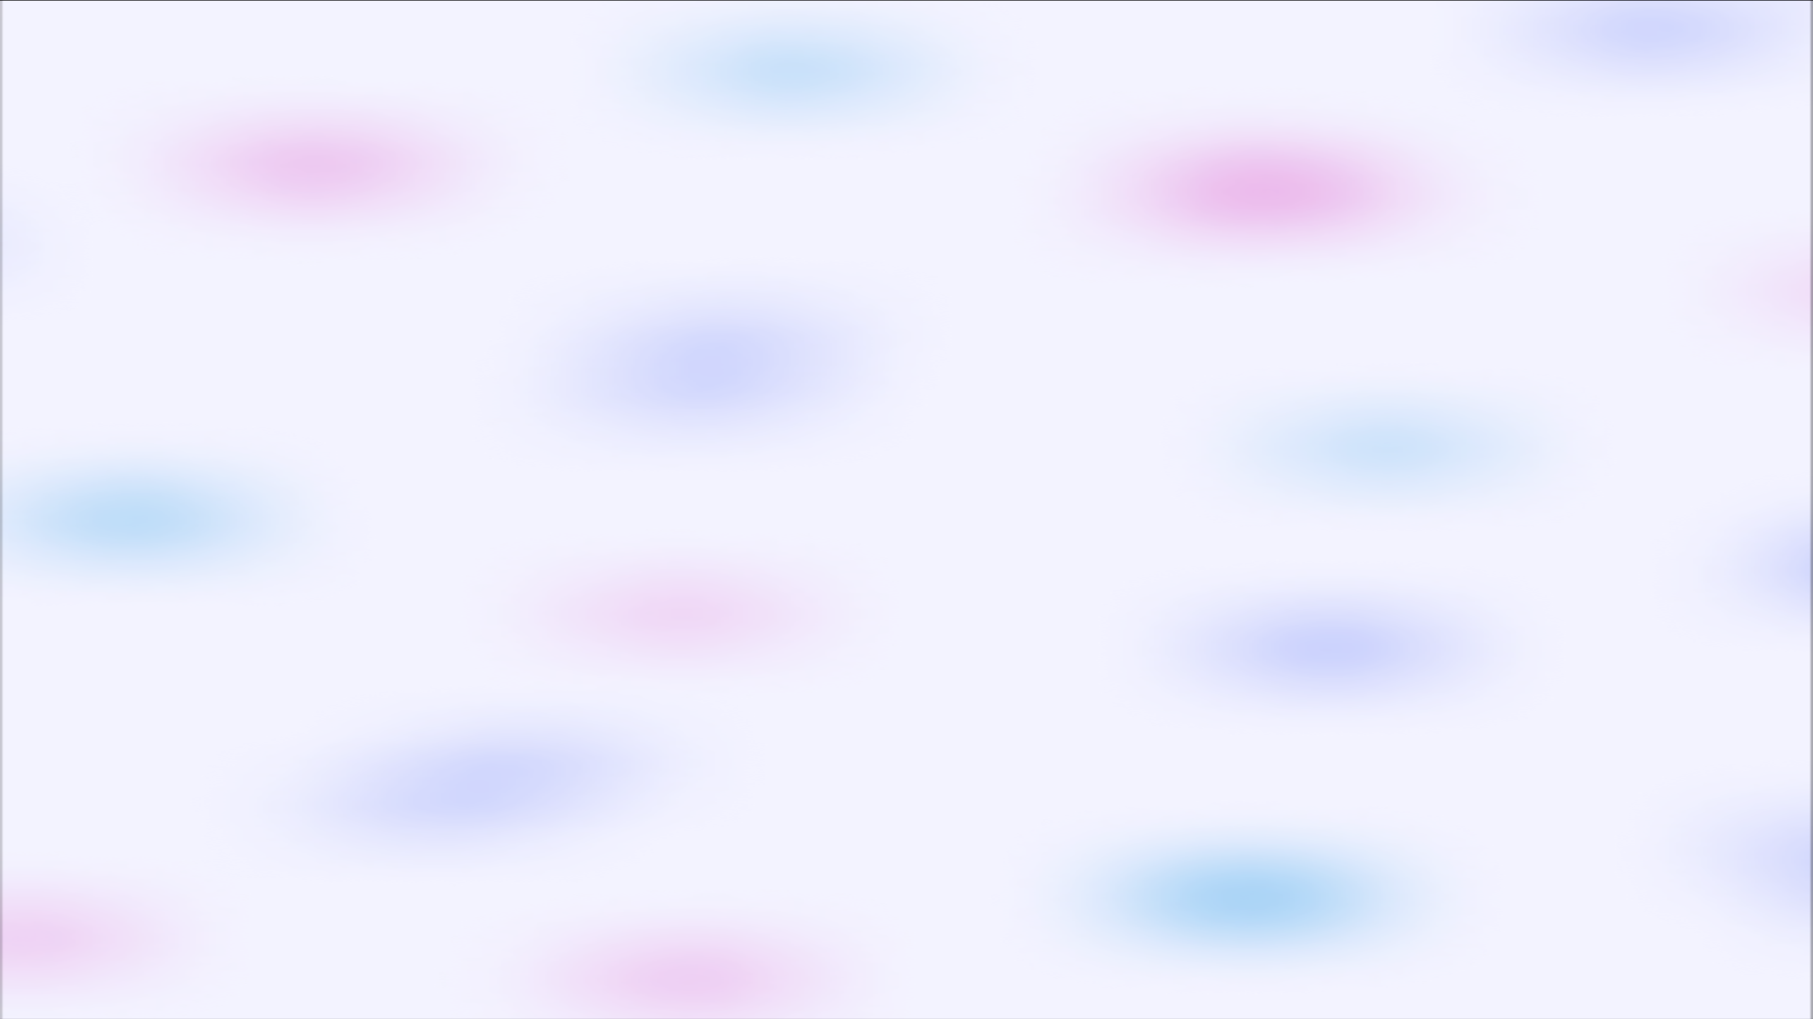
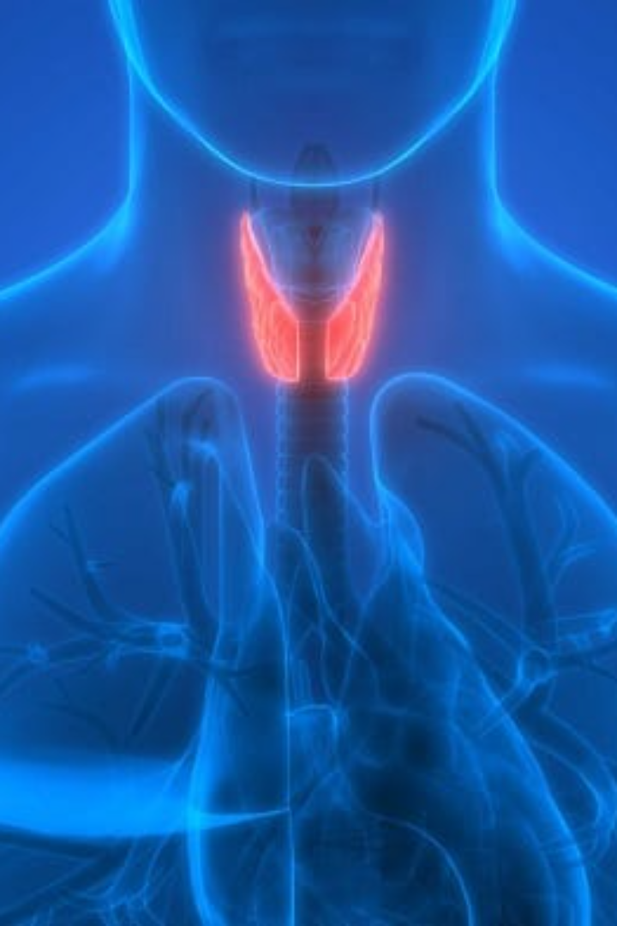


Thyroid Type Detection: Disease Diagnosis solution
A solution for transforming the way medical teams detect thyroid diseases, leading to faster and more accurate diagnoses.
by Kunal Liman
Imarticus PGA - 41

Slide 2

Problem Statement:
To create a Classification model using machine learning algorithms for predicting the type of Thyroid a person has, based on the patient' s data, aiding medical professionals in :
Accurate predictions
Efficiency in detecting Thyroid type
Reducing human error

Slide 3
1
2
3
4
5
6
Data Ingestion
Data Preprocessing
Data Clustering
Train Test Split for each cluster
Model selection for each cluster
Save model and Predict
Project Architecture: A Streamlined Workflow
A description of the process view of the architecture. Describes the tasks (processes) involved in the system's execution, from data ingestion to model selection and tuning, ensuring a robust and efficient system for thyroid disease detection.

Slide 4







Tools Used:
Tools : Python
Platform : Jupyter Notebook, Visual Studio Code
LibraryUsed : Numpy, Pandas, matplotlib, seaborn, Scikit-learn

Slide 5
Data Description
'age': Patient's age.
'sex': Patient's gender.
'on_thyroxine': Whether the patient is on thyroid medication.
'query_on_thyroxine': Whether the patient has queried about thyroid medication.
'on_antithyroid_medication': Whether the patient is on antithyroid medication.
'sick': Whether the patient is currently sick .
'pregnant': Whether the patient is pregnant.
'thyroid_surgery': Whether the patient has undergone thyroid surgery.
'I131_treatment': Whether the patient has received I131 treatment.
'query_hypothyroid': Whether the patient has queried about hypothyroidism 11.
'query_hyperthyroid': Whether the patient has queried about hyperthyroidism.
'lithium': Whether the patient is taking lithium medication.
'goitre': Whether the patient has a goitre (enlarged thyroid gland).
'tumor': Whether the patient has a thyroid tumor.
'hypopituitary': Whether the patient has hypopituitarism.
'psych': Whether the patient has a psychiatric condition.
'TSH_measured': Whether the TSH (Thyroid-Stimulating Hormone) level has been measured.
'TSH': TSH level in the patient's blood.
'T3_measured': Whether the T3 (Triodothyronine) level has been measured.
'T3': T3 level in the patient's blood.
'TT4_measured': Whether the TT4 (Total Thyroxine) level has been measured ('t' for True, 'f' for False).
'TT4': TT4 level in the patient's blood.
'T4U_measured': Whether the T4U (Thyroxine Uptake) level has been measured ('t' for True, 'f' for False).
'T4U': T4U level in the patient's blood.
'FTI_measured': Whether the FTI (Free Thyroxine Index) level has been measured ('t' for True, 'f' for False).
'FTI': FTI level in the patient's blood.
'TBG_measured': Whether the TBG (Thyroxine-Binding Globulin) level has been measured ('t' for True, 'f' for False).
'TBG': TBG level in the patient's blood.
'referral_source': The source of referral for the patient.
'Class': The class label indicating the thyroid condition
Target ‘Class’ Labels: negative, compensated_hypothyroid, primary_hypothyroid, secondary_hypothyroid
Continuous variables: 'age','TSH','T3','TT4','T4U','FTI’
Categorical variables: Leaving 'sex’, ‘referral_source’, ‘class’ all other variables have ‘t/f’ values.

Slide 6


Data Ingestion: Quality Assurance for Accurate Results
Validating the Data which is been Ingested from the source:
After validating the proper structure and Expectations for the data
further process of Data Preprocessing is started.
Schema Validation: Ensure data structure align with expectations.
Expected Columns : ['age', 'sex', 'on_thyroxine', 'query_on_thyroxine', 'on_antithyroid_medication’,
'sick', 'pregnant', 'thyroid_surgery', 'I131_treatment', 'query_hypothyroid’,
'query_hyperthyroid', 'lithium', 'goitre', 'tumor', 'hypopituitary', 'psych’,
'TSH_measured', 'TSH', 'T3_measured', 'T3', 'TT4_measured', 'TT4', 'T4U_measured', 'T4U’,
'FTI_measured', 'FTI', 'TBG_measured', 'TBG', 'referral_source', 'Class’]

Slide 7

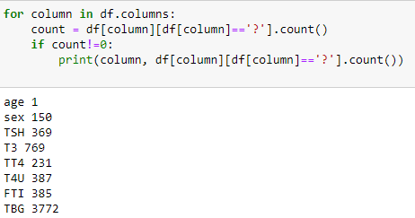
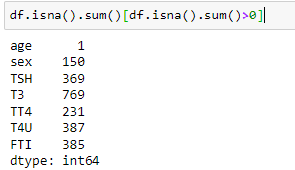
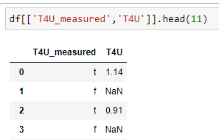
Data Preprocessing: Feature Engineering
Replacing missing values ('?') with nulls (np.nan) : Dataset has missing values that are replaced with invalid values like ‘?’
Drop unwanted columns : Some columns are with true and false values which is just the indication that whether the next column has
values or not. There is no point of having such columns in our dataset.
Example:

Slide 8
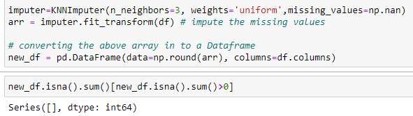
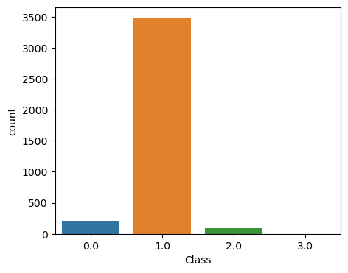
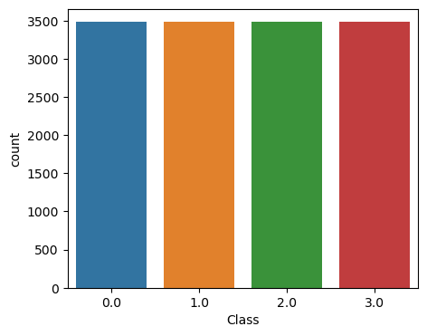
Encoding Categorical values using techniques like mapping, oneHotEncoding and LabelEncoder and saving the encoder for prediction.
Imputing null values with KNNImputer : Using nearest 3 neighbors we Impute the missing values.
Handling Imbalance using RandomOverSampler:
Saving the processed data for Clustering and Model building.

Slide 9

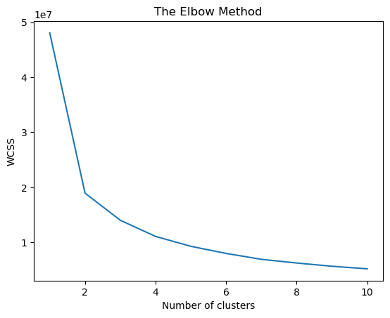
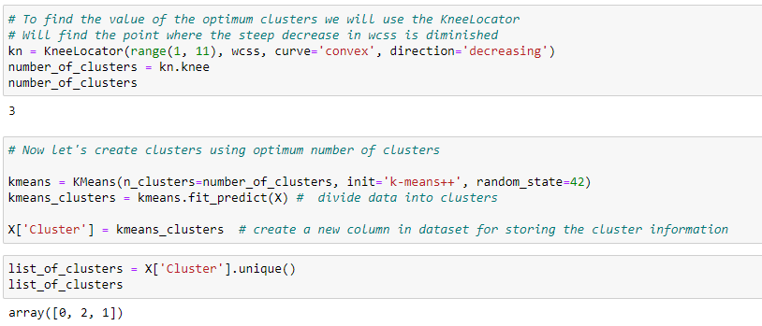
Data Clustering: Finding Patterns in Data for Enhanced Accuracy
Using the K-means clustering algorithm we identify distinct patterns and clusters within the data, enhancing the accuracy of our model in thyroid disease detection.
After Calculating WCSS (Within Cluster Sum Square) for clusters 1 to 10 we plot a Elbow plot and using KneeLocator we find the optimum number of clusters: 3
A column named ‘Cluster’ with cluster information is added in DataFrame. Now each record has assigned a cluster group from [ 0, 2, 1 ]

Slide 10

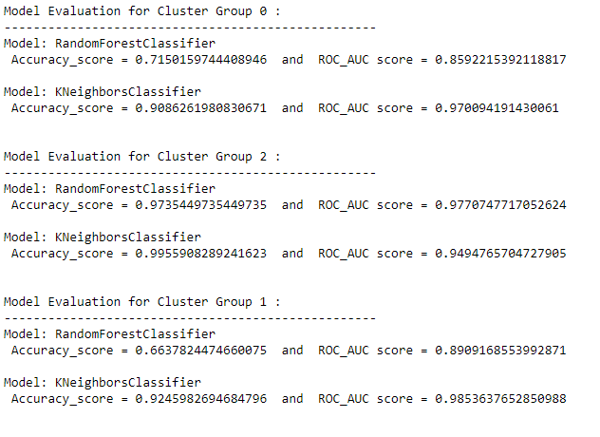
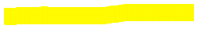
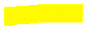

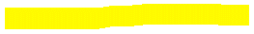
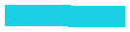
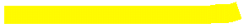

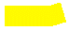

Model Selection for each Cluster
Using a for loop we segregate Clusters.
Perform train_test_split on the cluster.
Run the GridSearchCV for choosing the best parameters for RandomForestClassifier (RFC) and KNeighborsClassifier (KNN).
Using the best parameters run the model and evaluate them on the accuracy_score and roc_auc_score.
Comparing the scores we select and save the best model for each Cluster.

Slide 11
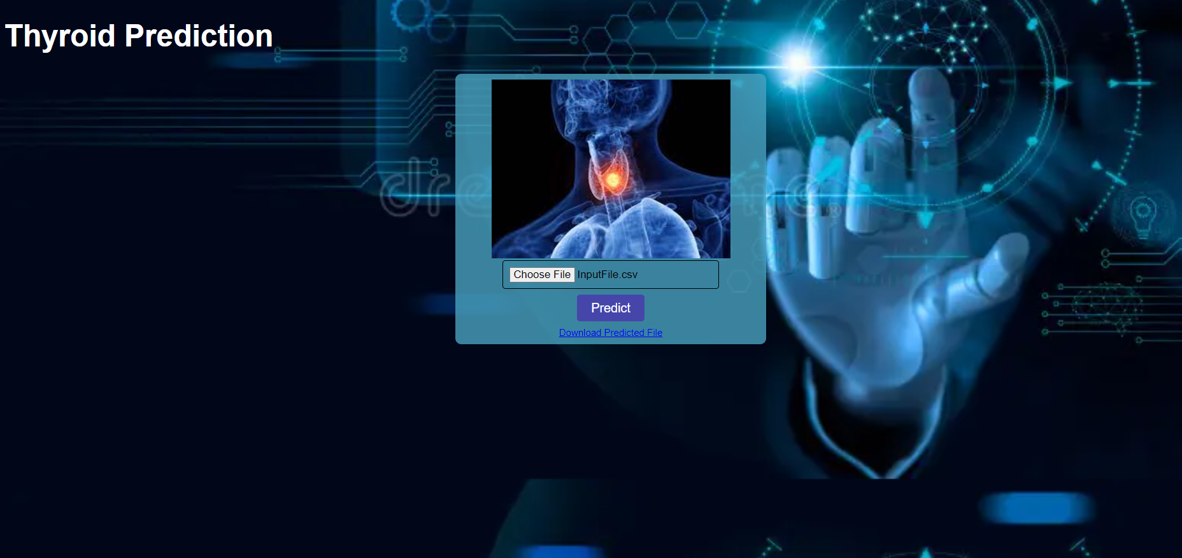
Prediction with the saved model on Input_CSV file

Slide 12
Conclusion: Thyroid Disease Detection
The thyroid disease detection solution will help the medical teams to detect thyroidal disease in patients based on the features, symptoms and quantity of 4 hormones. This solution eliminates human error and increases efficiency in diagnosing thyroid disease. After the prediction, necessary medical action will be taken by the concerned authorities.

Slide 13

References:
Data source: https://archive.ics.uci.edu/
Preprocessing: https://pypi.org/project/imbalanced-learn/
Google.com for images

